Slide 1

Machine Learning on Imbalanced Class Distributions
Thamme Gowda
May 27, 2021
(Group Meeting)

Slide 2
Overview
Imbalanced Classification
Methods
- Sampling - Augmentation
- Objective-based
- Weighted loss functions
- Smoothing
Experiment
- Image classification
- Mars images dataset
- Model and Training
- Results
Summary
Discussion
Why should we care?

Slide 3
Imbalanced Classification [1/2]
What: Classification problem where some classes are frequent, and others are rare
Why: Rare classes/types/phenomena are important
Examples:
Cancer detection:
Most people don’t have cancer -- label: NEGATIVE but some people do -- label: POSITIVE. Global average: ~1%; USA: ~5%
Performance on minority class(es) is important Say, imbalance is 99:1, majority class baseline gets 99% accuracy without any learning. Is it useful? No.
NLP/ natural language generation from Zipfian distribution:
Frequent words are stopwords, and rare words are often content words (but sometimes noise)
Performance on content words is more useful than stopwords; we even remove stopwords in some apps

Slide 4
Imbalanced Classification [2/2]
Out-of-the-box, ML techniques observe good performance on majority classes, but poor performance on minority classes. [Poor performance on rare classes]
Frequency based biases creep in
Common behavior: over-recall of majority classes, under-recall of minority classes
Evaluation:
Accuracy and such micro-average metrics could be misleading; they overlook rare classes
Macro-averaged metrics are strongly recommended (Recent work)
Next research question: What can we do for improving rare classes performance?

Slide 5

From Social Sciences...
“Affirmative action: set of policies and practices [within a govt or org] seeking to increase the representation of particular groups [based on their gender, race, sexuality, creed or nationality] in areas in which they are underrepresented such as education and employment” -- Wikipedia.org
Some countries use a quota system, whereby a certain percentage of government jobs, political positions, and school vacancies must be reserved for members of a certain group
E.g.,1: Reservation system in India
E.g.,2: USA employment-based immigration: 7% per-country ceiling
In some other regions where quotas are not used, minoritized group members are given preference or special consideration in selection processes
Examples: see scholarships for students
Imbalance is everywhere in nature...

Slide 6
Imbalanced Machine Learning: Methods
Sampling based methods
Up-sample minority class(es)
Down-sample majority class(es)
Augmentation methods
SMOTe: Synthetic Minority Oversample Technique
Modified Objectives:
Frequency based:
Weighted Cross Entropy
Likelihood based
Focal Loss
Label Smoothing
⬅ Focusing on Modified Objectives.
In NLP (our focus), imbalance is inevitable. Attaining class balance via sampling and synthetic augmentation is hard.

Slide 7
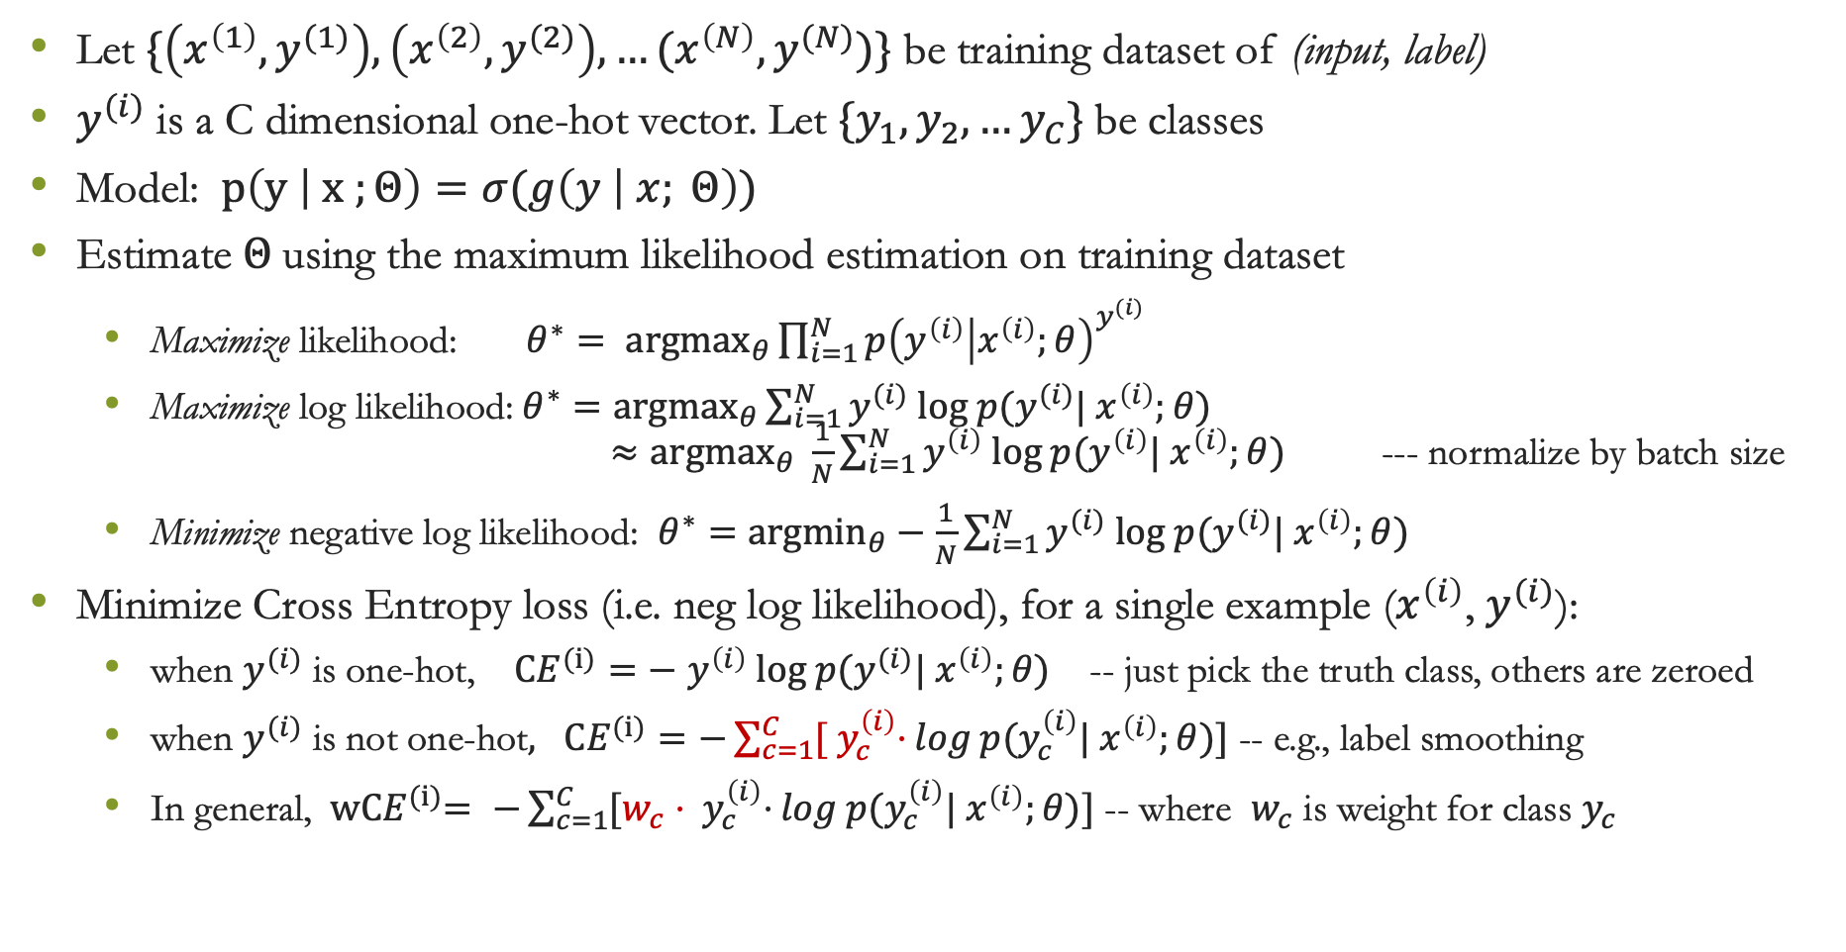
Cross Entropy
Let $\{\left(x^{\left(1\right)},y^{(1)}\right), \left(x^{\left(2\right)},y^{(2)}\right), …(x^{\left(N\right)},y^{(N)})\}$ be training dataset of (input, label)
$y^{(i)}$ is a C dimensional one-hot vector. Let ${\{y}_{1},y_{2},…y_{C}\}$be classes
Model: $p\left(y | x ;Θ\right)=σ(g\left(y | x; Θ\right))$
Estimate $Θ$using the maximum likelihood estimation on training dataset
Maximize likelihood: ${θ^{∗}= argmax}_{θ}\prod_{i=1}^{N}{p{\left(y^{\left(i\right)} | x^{\left(i\right)};θ\right)}^{y^{(i)}} }$
Maximize log likelihood:$θ^{∗}={argmax}_{θ}\sum_{i=1}^{N}{y^{(i)} log p(y^{(i)}| x^{\left(i\right)};θ)}$ $≈{argmax}_{θ} \frac{1}{N}\sum_{i=1}^{N}{y^{\left(i\right)} log p(y^{\left(i\right)}| x^{\left(i\right)};θ) }$ --- normalize by batch size
Minimize negative log likelihood: $θ^{∗}=$ ${argmin}_{θ}−\frac{1}{N}\sum_{i=1}^{N}{y^{(i)} log p(y^{(i)}| x^{\left(i\right)};θ)}$
Minimize Cross Entropy loss (i.e. neg log likelihood), for a single example ($x^{\left(i\right)}$, $y^{(i)}$):
when $y^{(i)}$ is one-hot, ${CE}^{(i)}=−$ $y^{\left(i\right)} log p(y^{(i)}| x^{\left(i\right)};θ)$ -- just pick the truth class, others are zeroed
when $y^{(i)}$ is not one-hot$, {CE}^{(i)}=−\sum_{c=1}^{C}{{[ y}_{c}^{\left(i\right)}⋅}log p(y_{c}^{\left(i\right)}| x^{\left(i\right)};θ)]$ -- e.g., label smoothing
In general, ${ wCE}^{(i)}= −\sum_{c=1}^{C}{{[w_{c}⋅ y}_{c}^{\left(i\right)}⋅}log p(y_{c}^{\left(i\right)}| x^{\left(i\right)};θ)]$ -- where $w_{c}$ is weight for class $y_{c}$

Slide 8
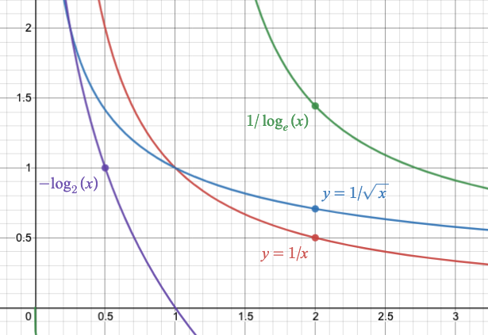
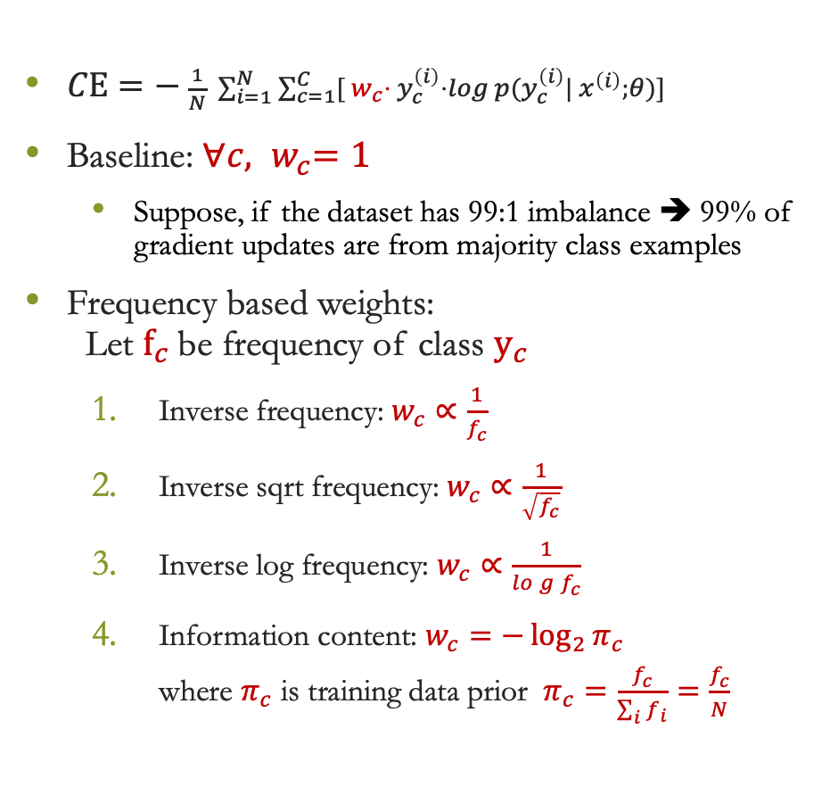
Weighted Cross Entropy
desmos.com/calculator/xjedqqsbpm
$CE=− \frac{1}{N} \sum_{i=1}^{N}{\sum_{c=1}^{C}{{[{ w}_{c}⋅ y}_{c}^{\left(i\right)}⋅}log p(y_{c}^{\left(i\right)}| x^{\left(i\right)};θ)]}$
Baseline: ${∀c, w}_{c}=1$
Suppose, if the dataset has 99:1 imbalance ➔ 99% of gradient updates are from majority class examples
Frequency based weights: Let $f_{c}$be frequency of class $y_{c}$
Inverse frequency: $w_{c}∝\frac{1}{f_{c}}$
Inverse sqrt frequency: $w_{c}∝\frac{1}{\sqrt{f_{c}}}$
Inverse log frequency: $w_{c}∝\frac{1}{log{f_{c}}}$
Information content: $w_{c}=−\log_{2}{π_{c}}$ where $π_{c}$ is training data prior $π_{c}=\frac{f_{c}}{\sum_{i}{f_{i}}}=\frac{f_{c}}{N}$
$1/x$ is too harsh, $1/\sqrt{x}$ is smooth and $1/\log\left(x\right)$ is smoother

Slide 9
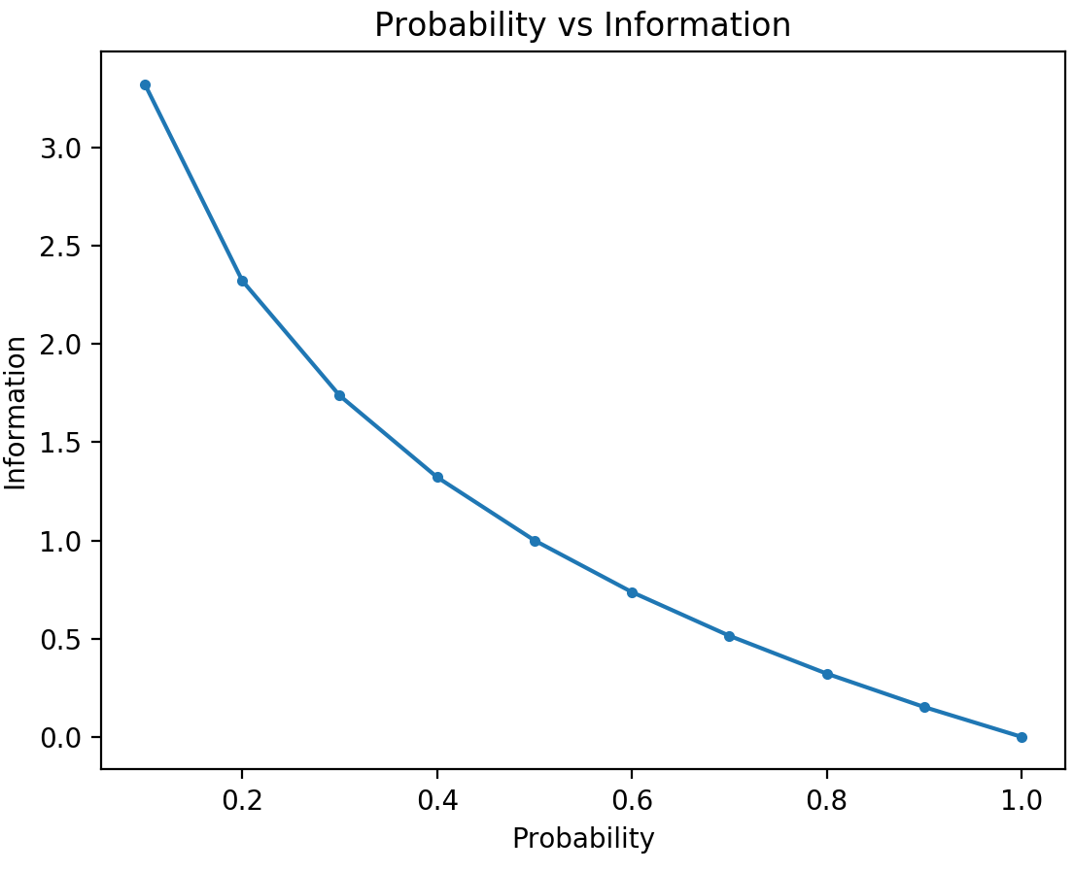
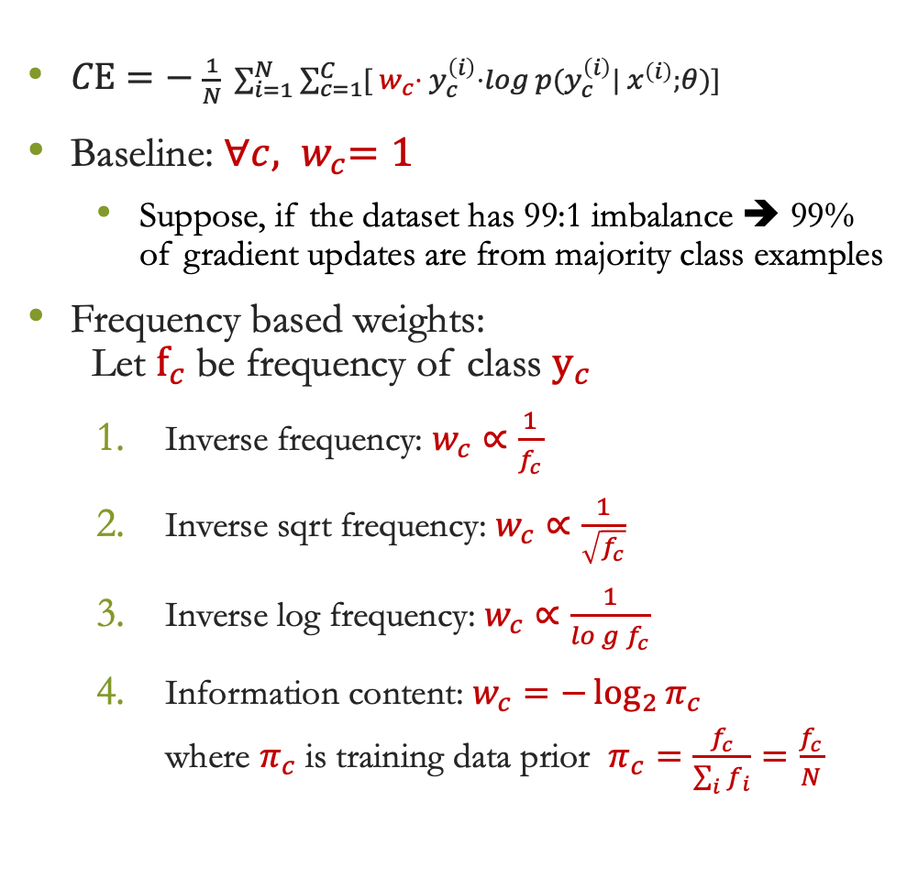
Weighted Cross Entropy
$CE=− \frac{1}{N} \sum_{i=1}^{N}{\sum_{c=1}^{C}{{[{ w}_{c}⋅ y}_{c}^{\left(i\right)}⋅}log p(y_{c}^{\left(i\right)}| x^{\left(i\right)};θ)]}$
Baseline: ${∀c, w}_{c}=1$
Suppose, if the dataset has 99:1 imbalance ➔ 99% of gradient updates are from majority class examples
Frequency based weights: Let $f_{c}$be frequency of class $y_{c}$
Inverse frequency: $w_{c}∝\frac{1}{f_{c}}$
Inverse sqrt frequency: $w_{c}∝\frac{1}{\sqrt{f_{c}}}$
Inverse log frequency: $w_{c}∝\frac{1}{log{f_{c}}}$
Information content: $w_{c}=−\log_{2}{π_{c}}$ where $π_{c}$ is training data prior $π_{c}=\frac{f_{c}}{\sum_{i}{f_{i}}}=\frac{f_{c}}{N}$
Notes:
$1/x$ is too harsh, $1/\sqrt{x}$ is smooth and $1/\log\left(x\right)$ is smoother

Slide 10
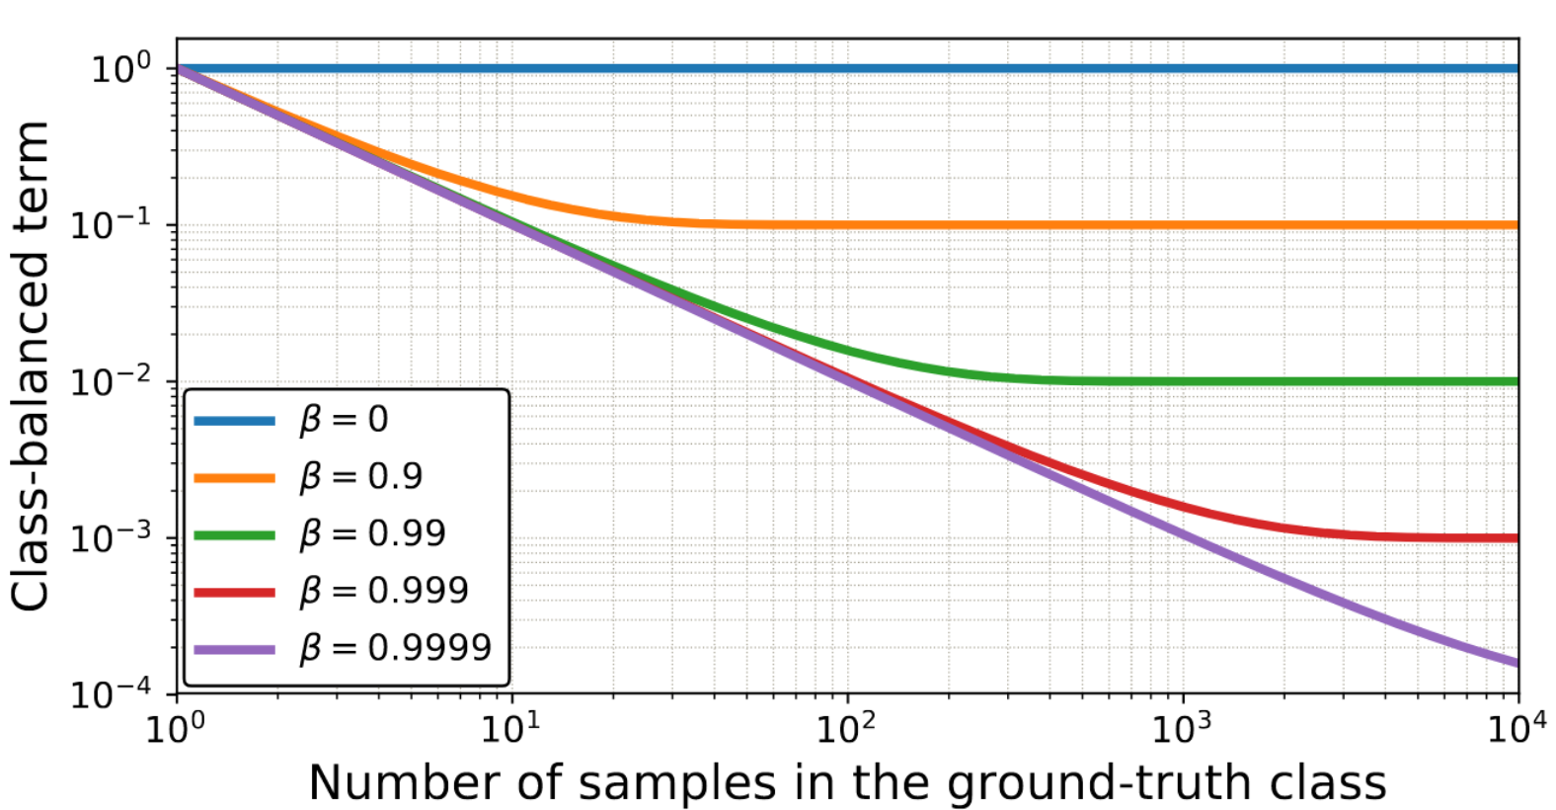
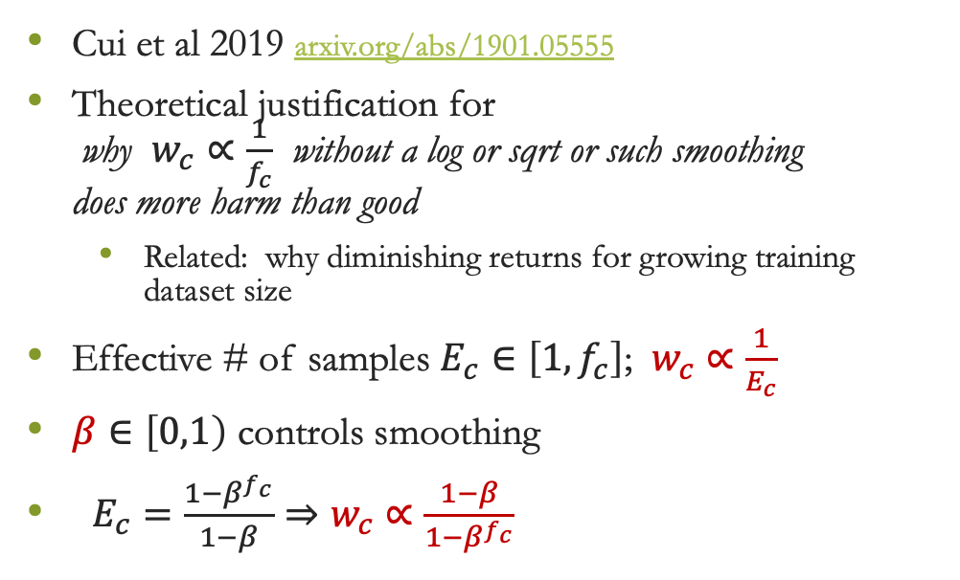
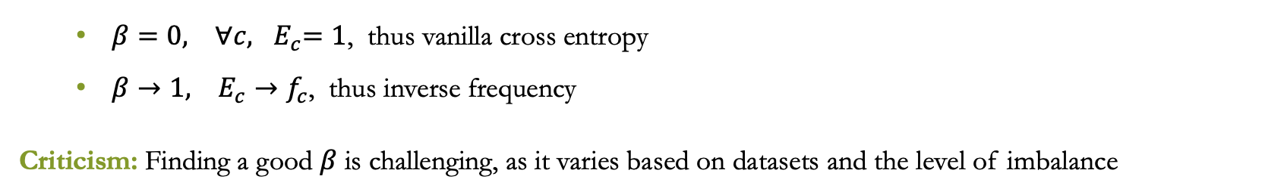
Effective Number of Samples
Cui et al 2019 arxiv.org/abs/1901.05555
Theoretical justification for why $w_{c}∝\frac{1}{f_{c}}$ without a log or sqrt or such smoothing does more harm than good
Related: why diminishing returns for growing training dataset size
Effective # of samples $E_{c}∈\left[1, f_{c}\right]$; $w_{c}∝\frac{1}{E_{c}}$
$β∈\left[0,1\right)$ controls smoothing
$E_{c}=\frac{1−β^{f_{c}}}{1−β}⇒w_{c}∝\frac{1−β}{1−β^{f_{c}}}$
$β=0, {∀c, E}_{c}=1$, thus vanilla cross entropy
$β→1, E_{c}→f_{c}$, thus inverse frequency
Criticism: Finding a good $β$ is challenging, as it varies based on datasets and the level of imbalance

Slide 11
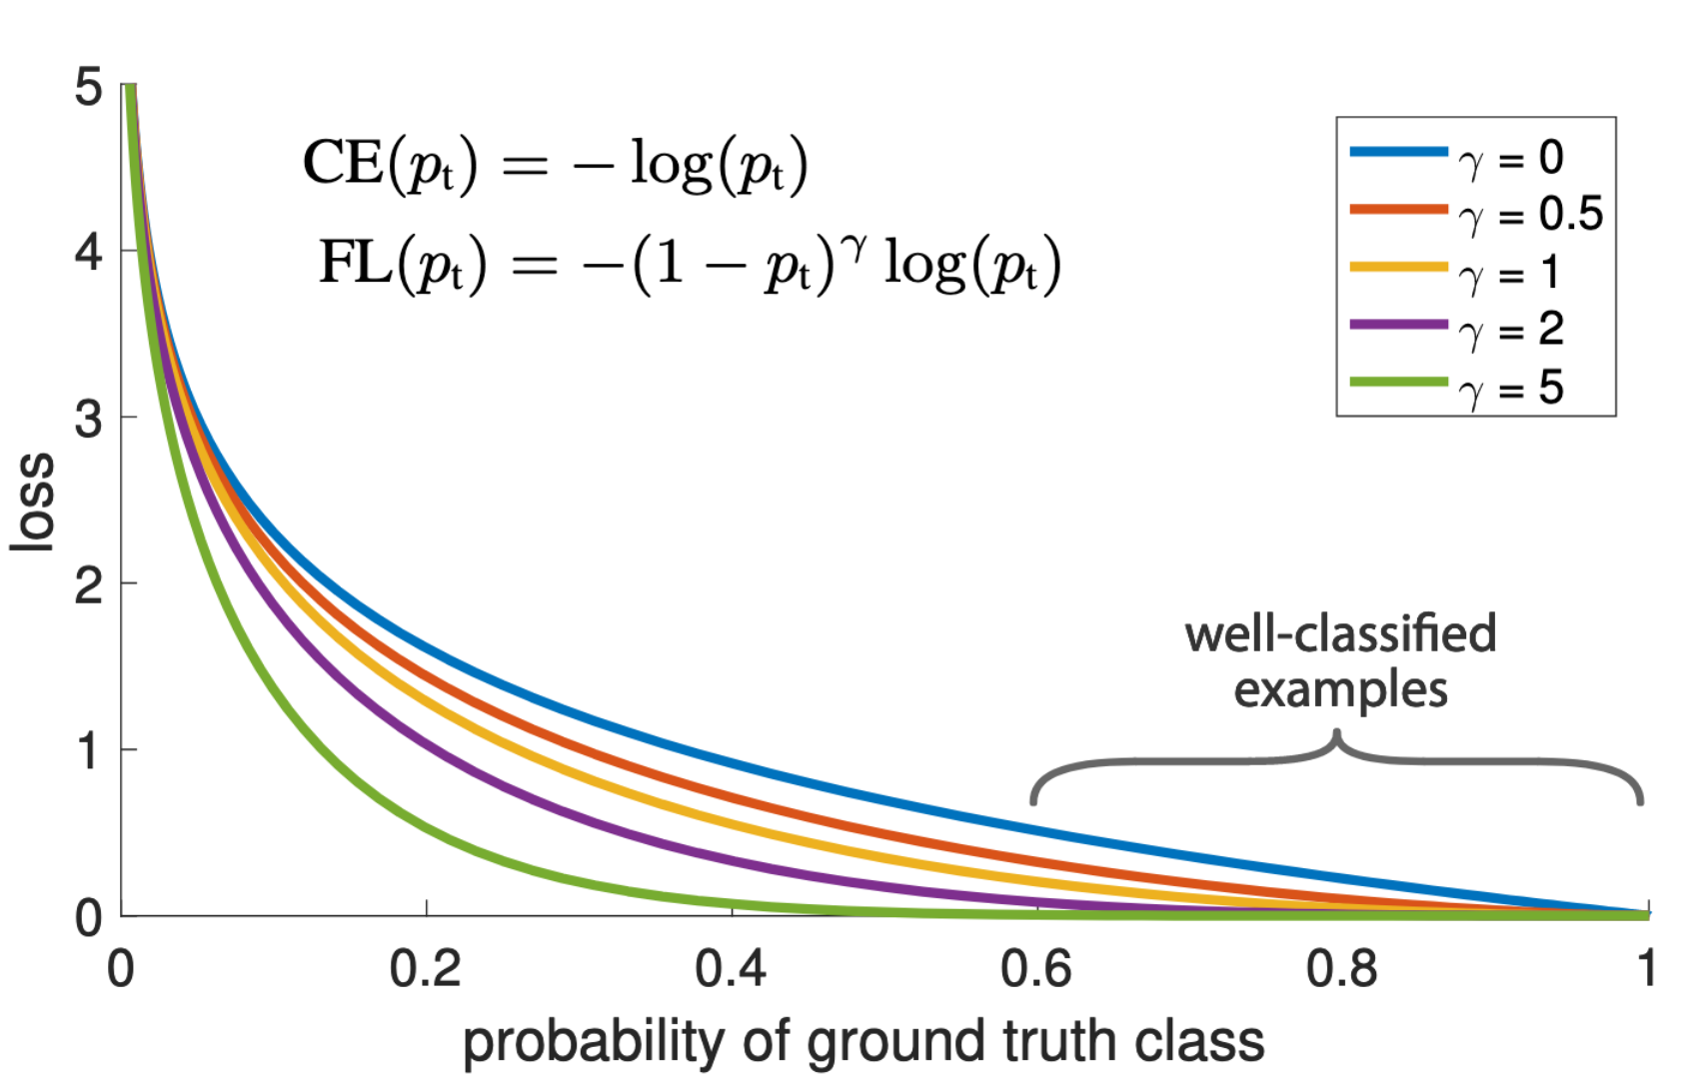
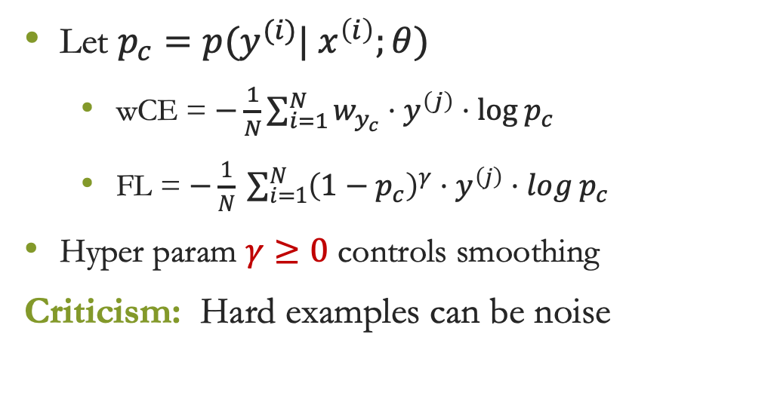
Focal Loss
Our assumption so far: rare classes are hard, frequent classes are easy
But... majority classes may also have hard examples as well, minority may have easy examples
Focal Loss – Yin et al 2017 arxiv.org/abs/1708.02002
Key Idea: Relax penalty for examples that are easy to classify
Let $p_{c}=p(y^{(i)}| x^{\left(i\right)};θ)$
wCE = $−\frac{1}{N}\sum_{i=1}^{N}{w_{y_{c}}⋅y^{\left(j\right)}⋅log p_{c}}$
FL = $−\frac{1}{N} \sum_{i=1}^{N}{{\left(1−p_{c}\right)}^{γ}⋅y^{\left(j\right)}⋅log p_{c}}$
Hyper param $γ≥0$ controls smoothing
Criticism: Hard examples can be noise

Slide 12
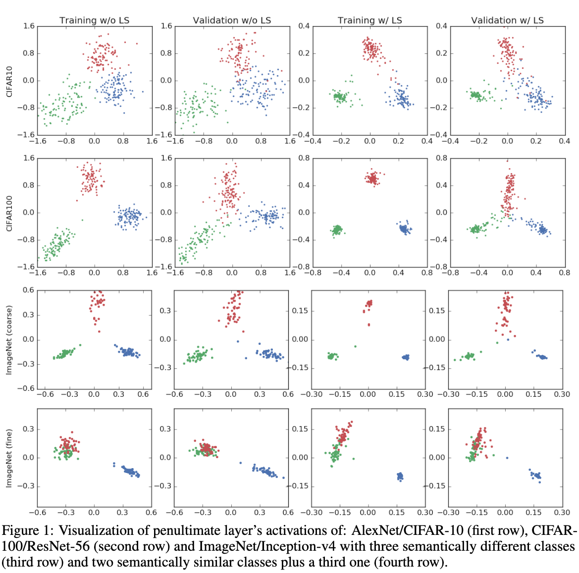
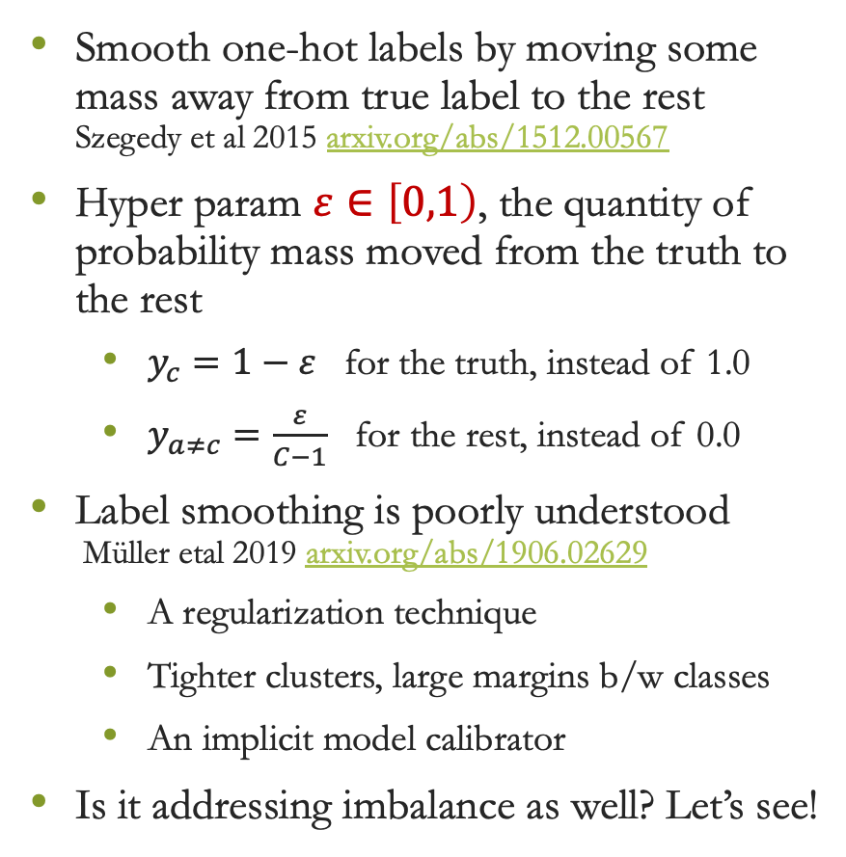
Label Smoothing
Smooth one-hot labels by moving some mass away from true label to the rest Szegedy et al 2015 arxiv.org/abs/1512.00567
Hyper param $ε∈\left[0,1\right)$, the quantity of probability mass moved from the truth to the rest
$y_{c}=1−ε$ for the truth, instead of 1.0
$y_{a≠c}=\frac{ε}{C−1}$ for the rest, instead of 0.0
Label smoothing is poorly understood Müller etal 2019 arxiv.org/abs/1906.02629
A regularization technique
Tighter clusters, large margins b/w classes
An implicit model calibrator
Is it addressing imbalance as well? Let’s see!

Slide 13
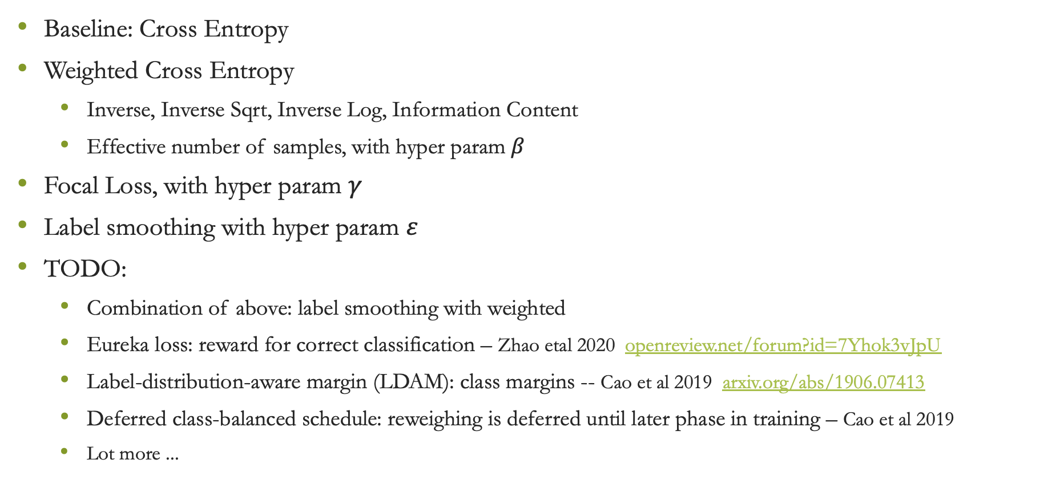
Summary: Imbalanced Learning Methods
Baseline: Cross Entropy
Weighted Cross Entropy
Inverse, Inverse Sqrt, Inverse Log, Information Content
Effective number of samples, with hyper param $β$
Focal Loss, with hyper param $γ$
Label smoothing with hyper param $ε$
TODO:
Combination of above: label smoothing with weighted
Eureka loss: reward for correct classification – Zhao etal 2020 openreview.net/forum?id=7Yhok3vJpU
Label-distribution-aware margin (LDAM): class margins -- Cao et al 2019 arxiv.org/abs/1906.07413
Deferred class-balanced schedule: reweighing is deferred until later phase in training – Cao et al 2019
Lot more ...

Slide 14
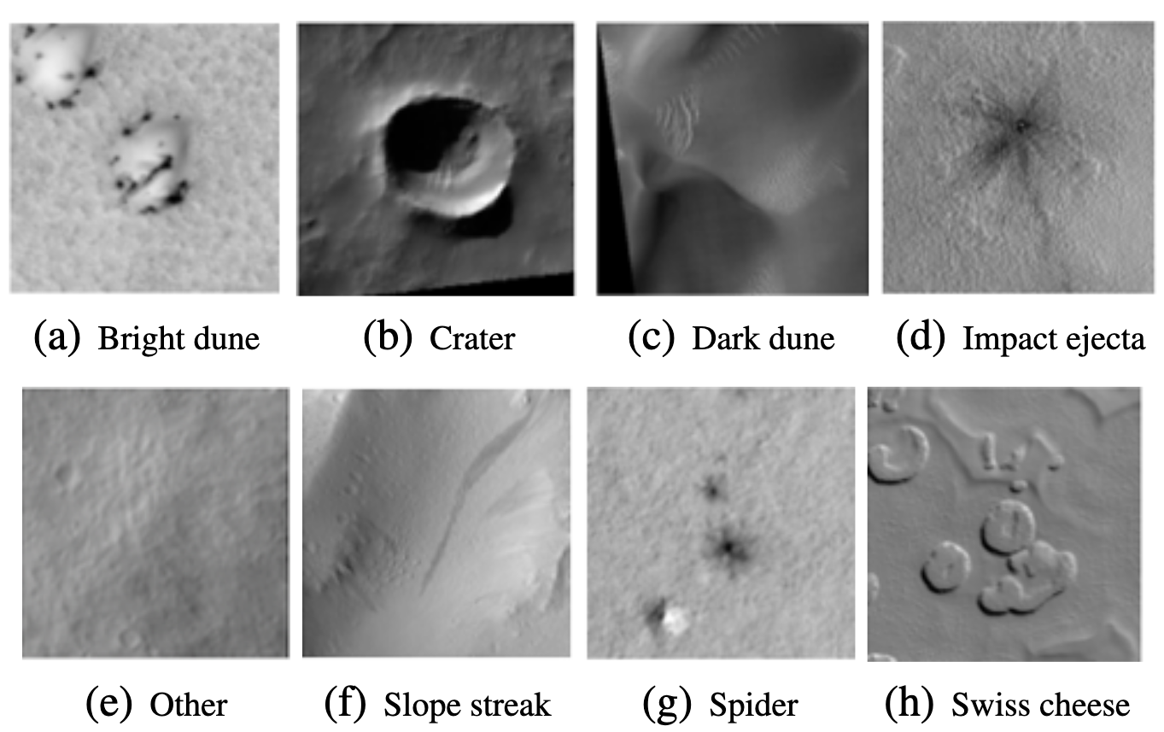
Experiment Setup
Class | Train Freq | Train % | Val Freq | Val %
Other | 40,019 | 81.71 | 11,221 | 79.16
Crater | 3,598 | 7.35 | 1,337 | 9.43
Bright Dune | 1,561 | 3.19 | 77 | 0.54
Swiss Cheese | 1,281 | 2.62 | 511 | 3.60
Slope Streak | 924 | 1.89 | 602 | 4.25
Spider | 637 | 1.30 | 217 | 1.53
Dark Dune | 616 | 1.26 | 84 | 0.59
Impact Ejecta | 343 | 0.70 | 126 | 0.89
Total | 48,979 | 100 | 14,175 | 100
Problem: Image Classification
Easier than machine translation, so I can understand better
Dataset:
High Resolution Imaging Science Experiment (HiRISE) v3.2 -- Images taken from Mars satellites
8 classes, naturally imbalanced
Model:
ResNeXt -- torchvision.models.resnext50_32x4d()
Last layer is adapted to 8 classes
Training:
Hyper params based on best validation MacroF1
Weights: random initialization Optimizer: Adam LR:0.0005 Trained until convergence

Slide 15
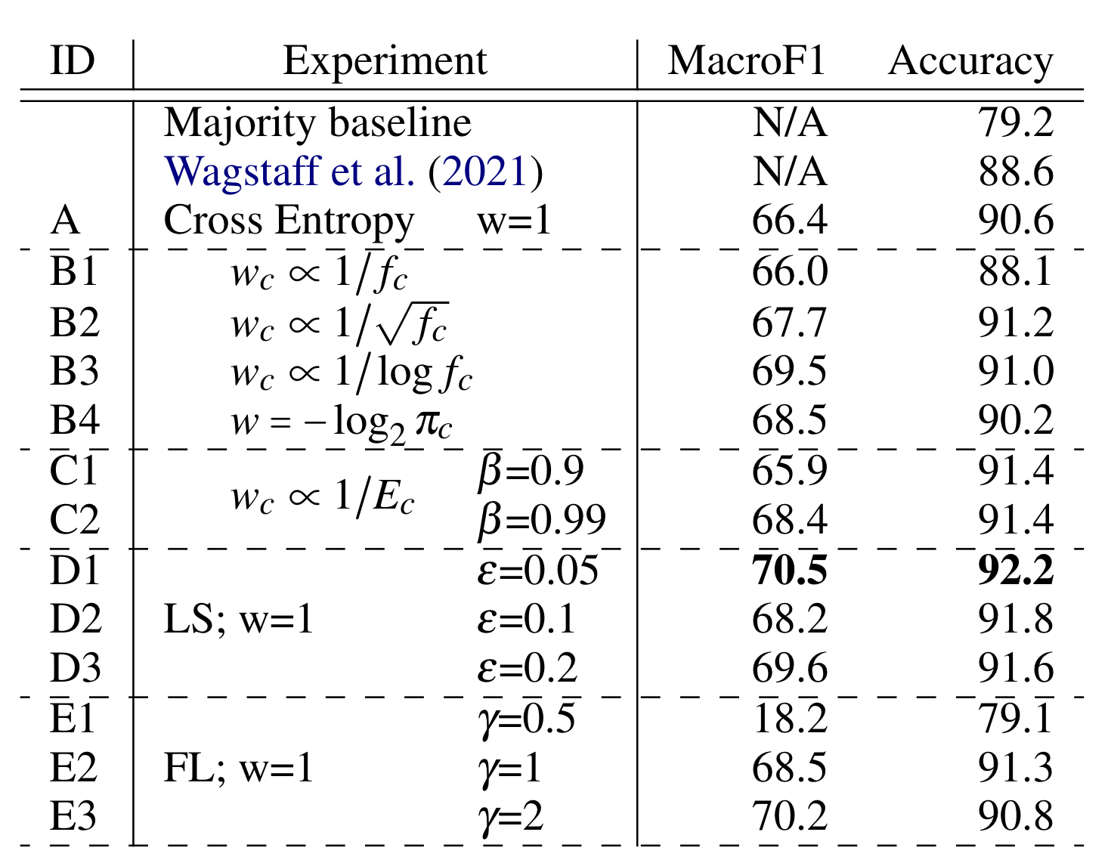
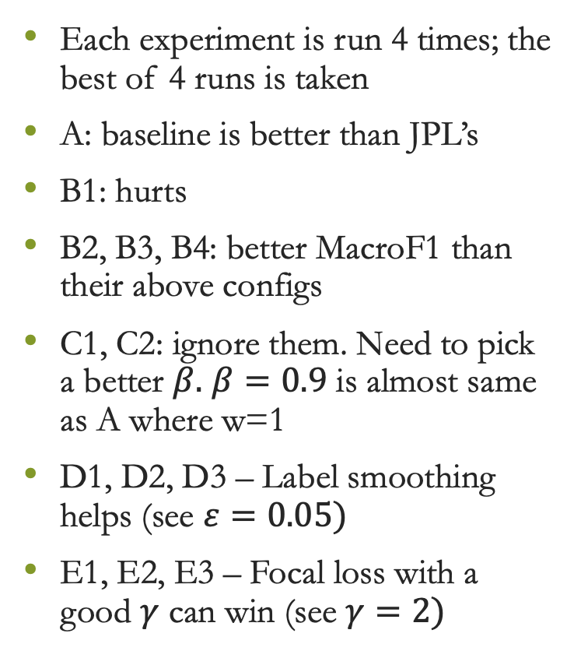
Results: Validation Set
Each experiment is run 4 times; the best of 4 runs is taken
A: baseline is better than JPL’s
B1: hurts
B2, B3, B4: better MacroF1 than their above configs
C1, C2: ignore them. Need to pick a better $β.$ $β=0.9$ is almost same as A where w=1
D1, D2, D3 – Label smoothing helps (see $ε=0.05)$
E1, E2, E3 – Focal loss with a good $γ$ can win (see $γ=2)$
TODO: combine Label smoothing with others

Slide 16
Validation Set F-1 Measures
Promising results
Improvements in MacroF1 and Accuracy
Class | Train% | A | B1 | B2 | B3 | B4 | C1 | C2 | D1 | D2 | D3 | E2 | E3
Other | 81.7 | 94.6 | 93.1 | 95.1 | 94.9 | 94.3 | 95.1 | 95.4 | 95.6 | 95.4 | 95.3 | 95.0 | 94.7
Crater | 7.3 | 78.2 | 75.3 | 79.2 | 79.5 | 76.3 | 79.1 | 80.4 | 78.9 | 80.9 | 78.2 | 80.4 | 75.9
Bright Dune | 3.2 | 64.7 | 74.4 | 65.4 | 58.5 | 75.0 | 55.3 | 76.5 | 84.1 | 85.0 | 65.2 | 74.9 | 83.1
Swiss Cheese | 2.6 | 87.7 | 90.7 | 92.8 | 92.0 | 92.1 | 90.7 | 90.2 | 93.7 | 90.4 | 93.3 | 89.4 | 87.7
Slope Streak | 1.9 | 68.9 | 61.6 | 72.8 | 72.6 | 72.3 | 74.9 | 71.3 | 75.1 | 73.4 | 73.6 | 64.7 | 67.7
Spider | 1.3 | 59.7 | 65.0 | 66.1 | 66.5 | 69.6 | 60.1 | 61.1 | 65.0 | 60.2 | 56.6 | 68.4 | 74.1
Dark Dune | 1.3 | 58.1 | 36.3 | 49.8 | 54.2 | 62.8 | 47.7 | 54.3 | 52.4 | 60.3 | 52.4 | 47.7 | 51.8
Impact Ejecta | 0.7 | 19.2 | 31.5 | 20.1 | 37.6 | 5.9 | 24.1 | 17.8 | 18.8 | 0.0 | 42.3 | 27.4 | 26.9
MacroF1 |  | 66.4 | 66.0 | 67.7 | 69.5 | 68.5 | 65.9 | 68.4 | 70.4 | 68.2 | 69.6 | 68.5 | 70.2
Accuracy |  | 90.6 | 88.1 | 91.2 | 91.0 | 90.2 | 91.4 | 91.4 | 92.2 | 91.8 | 91.6 | 91.2 | 90.8

Slide 17
Last Slide
Next steps
TODO1: try the combinations : label smoothing with weights
TODO2: try re-weighting based on mini-batch frequencies instead of whole batch (i.e. dataset)
TODO3: Eureka loss, and other works I may have missed
TODO4: machine translation
Discussion and any other suggestions?
Thanks

